Slide 1
SAE 24 S2
Oral presentations of work experience

Slide 2
SUMMARY
Presentation of myself
My routes
My company
My work…

Slide 3
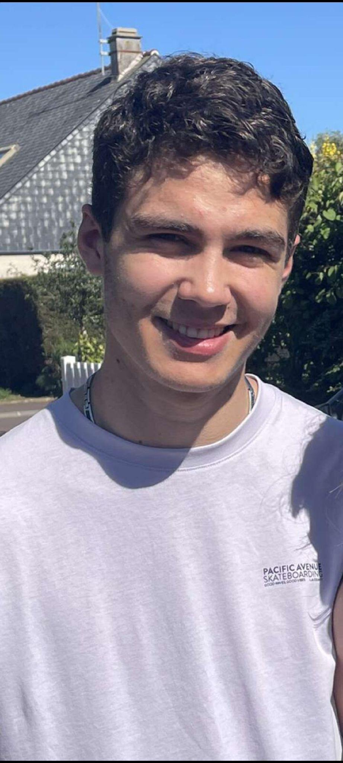
Myself
Louis COURTEILLE
18 years
IUT of Saint-Malo

Slide 4
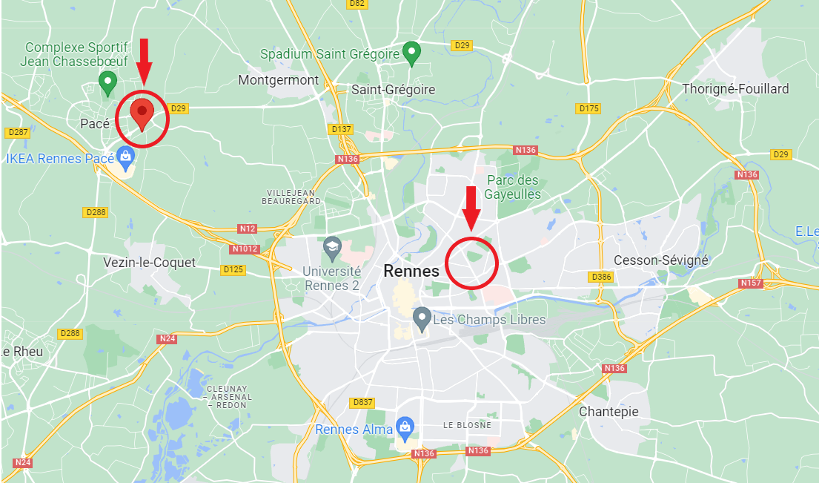
AXIANS
HOME

Slide 5
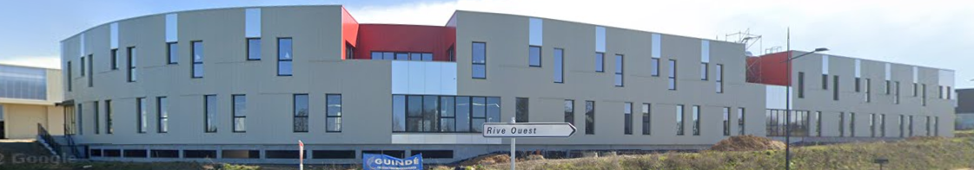
My company
AXIANS PACE

Slide 6



Partner

Slide 7

Axians

Slide 8
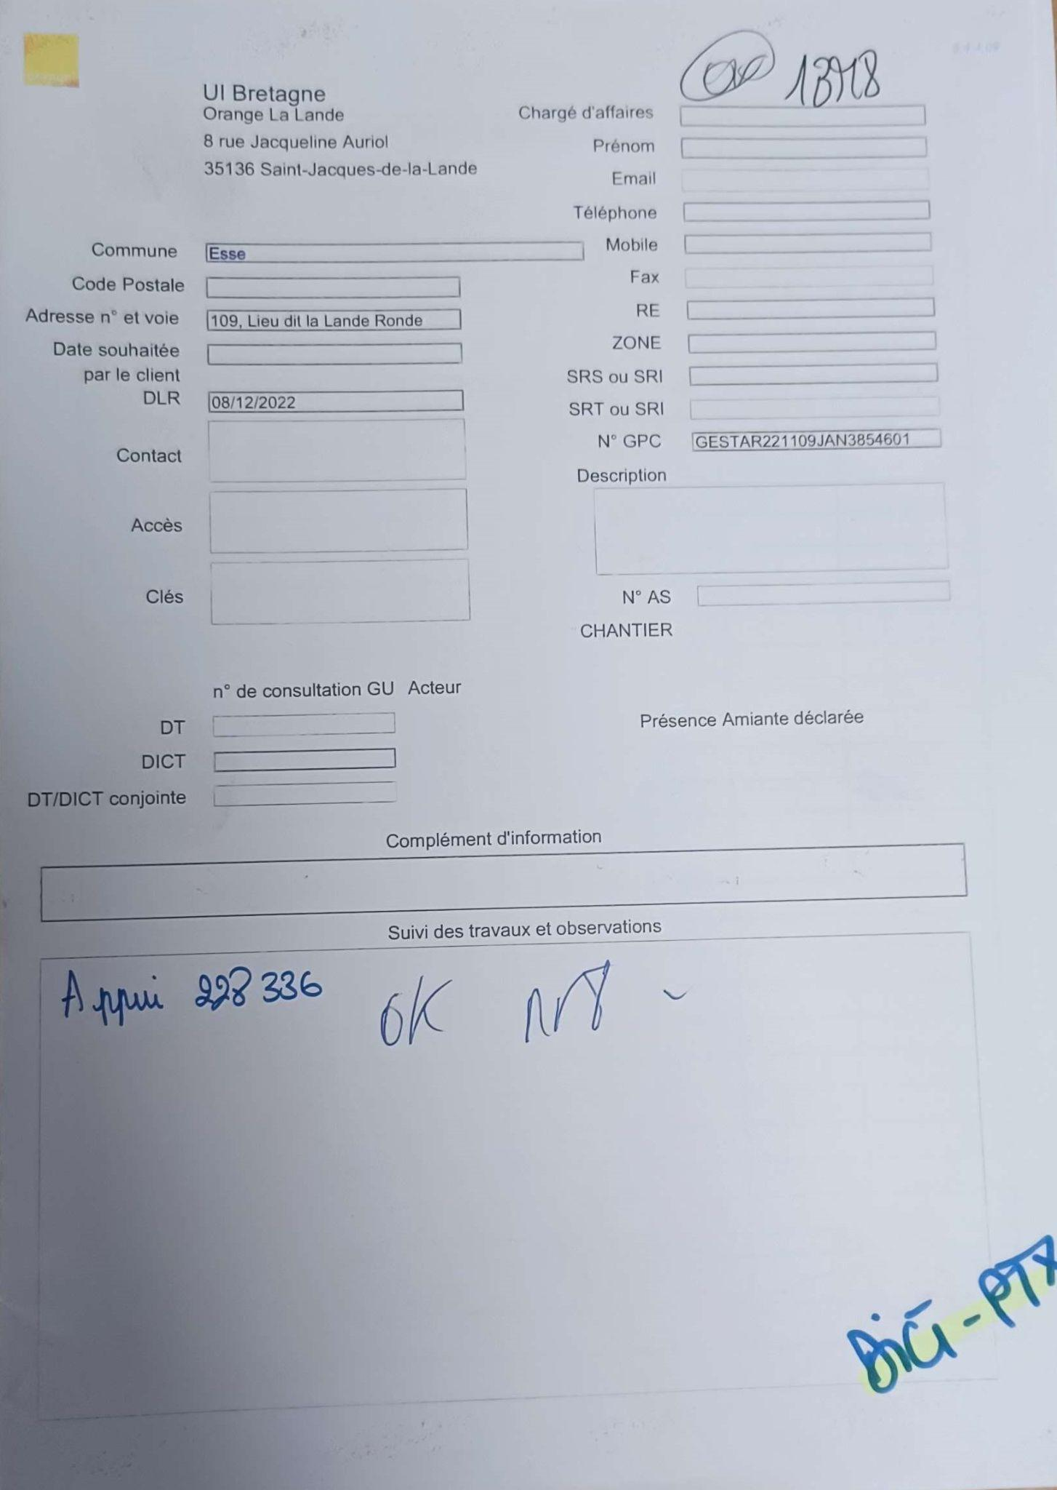
Standard file
POI PTX / GESTAR GC
ACF ACD

Slide 9





Applications
Line
Excel
Praxedo
Word
Teams

